Slide 1
Sparse Weight Compression and Decompression for Intel® Advanced Matrix Extensions (Intel® AMX) to Improve Deep Learning Performance
IEEE International Symposium on Workload Characterization’ 22
Presenter: Sreekanth Yalachigere (Intel)
Contributors: Shamima Najnin, Rajesh Poornachandran , Mona Minakshi, Anik Khan, Ofir, Nilesh Jain, Md Faijul Amin, Denis Samoylov, Guy Boudoukh, Tatyana Primak, Pallavi G

Slide 2
Unstructured Sparse Weights Compression
Agenda
Background & Motivation
Unstructured Sparsity in Machine Learning Models
Unstructured Sparsity
Quantization Workflow and Sparsity Introduction to Models
Zero Compression
4th Gen Intel® Xeon® Scalable processors, formerly codenamed Sapphire Rapids
Intel® Advanced Matrix Extensions (Intel® AMX)
Implementation
Framework, oneAPI Deep Neural Network Library (oneDNN), compression and decompression of sparse weights
Performance
Results
Processor Counter Monitor (PCM)

Slide 3
BACKGROUND & MOTIVATION

Slide 4
Memory Bandwidth in Machine Learning Inference
Deep Neural Network (DNN) models designed with billions of parameters need significant computational and memory resources.
Models are growing big, every year [1]
Recommender systems, Natural Language Processing (NLP) /Long-short term memory (LSTM) shifts the bottleneck from compute to memory bound.
These use cases are ~90% of AI inference workload mix in datacenters [2]
Memory Bandwidth is not scaling with Compute scaling over years.
From Intel architectures Broadwell to Sapphire Rapids, compute scaling (INT8 FLOPs) has increased at significantly higher rate than memory scaling (theoretical max memory BW) [3]
Cost of Memory is increasing
Bandwidth bottleneck
between DRAM memory and L3 cache
L3 cache to L1/L2 cache
Memory is one of the biggest challenges in deep neural networks (DNNs) today!!!
[1] Liang, Tailin, et al. "Pruning and quantization for deep neural network acceleration: A survey." Neurocomputing 461 (2021): 370-403
[2] Jouppi, Norman P., et al. "In-datacenter performance analysis of a tensor processing unit." Proceedings of the 44th annual international symposium on computer architecture. 2017
[3] https://www.crucial.com/articles/about-memory/difference-among-ddr2-ddr3-ddr4-and-ddr5-memory
Notes:
References

Slide 5
Sparse Weights Compression as Solution
Core L1/L2 AMX/TMUL
Core L1/L2 AMX/TMUL
Improved Cache BW
Cache BW bottleneck
LLC Cache
LLC Cache
Improved Memory BW
Memory BW bottleneck
Input Data, Activations
DRAM Memory
Input Data, Activations
DRAM Memory
Compressed INT8 Sparse Weights
INT8 Sparse Weights
ZERO COMPRESS
Post-Training Quantization
INT8 Sparse Weights
Post-Training Quantization
FP32 Sparse Weights
FP32 Sparse Weights
Pruning
Pruning
FP32 Dense Weights
FP32 Dense Weights
Existing solution
Proposed solution

Slide 6
Memory bandwidth bottleneck during execution
1
Weights
reorder
Weights are reordered to memory blocked layout to achieve better vectorization and cache reuse
1
Blocked memory Weights
Blocked memory Weights
Blocked memory Weights
Blocked memory Weights
DRAM
Reordered weights are read to cache during execution Memory BW Bottleneck
2
2
3
Larger weights are read to AMX tiles during execution
Cache BW Bottleneck
LLC Cache
CPU
3
oneDNN memory format: https://docs.oneapi.io/versions/latest/onednn/dev_guide_understanding_memory_formats.html

Slide 7
UNSTRUCTURED SPARSITY

Slide 8
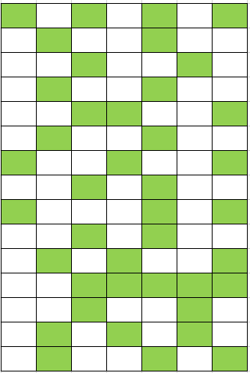
Unstructured Sparsity in AI
Sparsity is possible in deep learning because
Sparsity is gaining popularity to reduce the memory footprint of ever growing DNNs [1]
By the end of network training, only a subset of weights have acquired a meaningful purpose in determining the learned output
In some models, 90% of the weights can be pruned with little loss in accuracy which resulted in unstructured sparse weight matrices. [2]
Can we compress Unstructured Sparse weights to reduce memory bandwidth?
[1] Hoefler, Torsten, et al. "Sparsity in Deep Learning: Pruning and growth for efficient inference and training in neural networks." Journal of Machine Learning Research 22.241 (2021): 1-124. [2] https://arxiv.org/abs/2008.11849

Slide 9
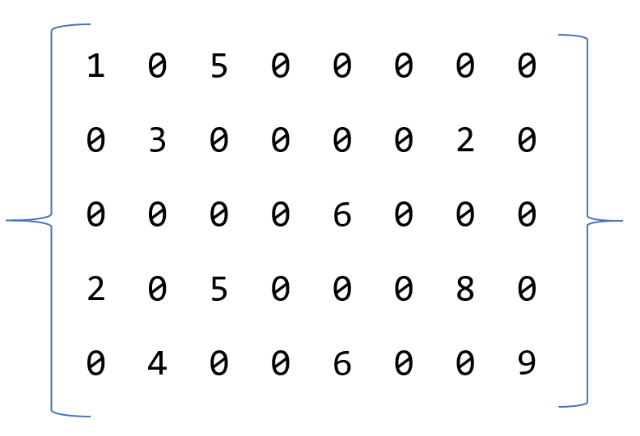
Zero Compression
Zero Compression
Loss less compression
Technique which drops “0” from the weight tensor and use bitmap for tracking the index of non-zeroes value
By compressing sparse weights, we will reduce the memory footprint
Assembly Instructions to compress and decompress a cache line (64 bytes)
vcompresspd and vpexpandb [1]
Loss less compression & AVX512 support to compress /decompress
[1] https://www.intel.com/content/www/us/en/docs/intrinsics-guide/index.html#text=VCOMPRESSPD https://www.intel.com/content/www/us/en/docs/intrinsics-guide/index.html#text=vpexpandb&ig_expand=2949
Sparse matrix has lots of zero values
Zero Compressed Matrix
10100000010000100000 10001010001001001001
Zero Compressed Matrix
Notes:
References
https://www.intel.com/content/www/us/en/docs/intrinsics-guide/index.html#text=VCOMPRESSPD&ig_expand=2949,1435
https://www.intel.com/content/www/us/en/docs/intrinsics-guide/index.html#text=vpexpandb&ig_expand=2949

Slide 10
Quantization Workflow
Convert model to bfloat16 precision
Quantize model with dynamic scale and shift parameters
Freeze weight-variables as constant
Calibrate scale and shift parameters
Train model with float32 precision
Optimized quantized model
Sparsity Introduction to Models https://arxiv.org/pdf/2111.05754.pdf

Slide 11
INTRODUCTION TO AMX Intel® Advanced Matrix Extensions (Intel® AMX)

Slide 12
4th Gen Intel® Xeon® Scalable Processor supporting Intel® Deep Learning Boost (Intel® DL Boost)- Built-in AI Acceleration
2023
2021
4th Gen Intel® Xeon® Scalable processors
Intel® Advanced Vector Extensions 512
(Intel® AVX-512)
-Up to two 512-bit FMAs
- 512-bit FP and Integer
- FP32 datatype
Intel® DL Boost
- VNNI/INT8 datatype +
Intel® AVX-512 instr.
Intel® Advance Matrix Extensions (AMX)®
Intel® DL Boost
- VNNI/INT8 datatype +
Intel® AVX-512 instr.
2019
3rd Gen Intel® Xeon® Scalable processors
2nd Gen Intel® Xeon® Scalable processors
2017
1st Gen Intel® Xeon® Scalable processors
…
Since 2001:
128-bit vectors
Increased throughput for Deep Learning
Notes:
Source: Intel Architecture Day 2021

Slide 13
Intel® Advanced Matrix Extensions (Intel® AMX)
Tiled Matrix Multiplication Accelerator - Data Center
AMX 2048 int8
8x
operations / cycle / core
VNNI 256 int8
See backup for workloads and configurations. Results may vary.
Notes:
Source: Intel Architecture Day 2021

Slide 14
Intel® Advanced Matrix Extensions (Intel® AMX)
Tiled Matrix Multiplication Accelerator - Data Center
AMX architecture has two components:
Tiles
A new expandable 2D register file – 8 new registers, 1Kb each: T0-T7
Register file supports basic data operators – load/store, clear, set to constant, etc.
TILES declares the state and is OS-managed by XSAVE architecture
C
A
B
C1
A1
B1
+=
x
TMUL
Set of matrix multiplication instructions, the first operators on TILEs
A MAC computation grid calculates ‘tiles’ of data
TMUL – performs Matrix ADD-Multiplication (C=+A*C) using three Tile registers (T2=+T1*T0)
TMUL requires TILE to be present
C2
A2
(AMX)
Express more work per instruction and per µop – save power for fetch/decode/OOO
Reference: Architecture Instruction Set Extensions. Chapter 3: INTEL® AMX INSTRUCTION SET REFERENCE https://software.intel.com/sites/default/files/managed/c5/15/architecture-instruction-set-extensions-programming-reference.pdf
Notes:
Source: Intel Architecture Day 2021

Slide 15
oneAPI Deep Neural Network Library Basic Information
Features:
API: C, C++, SYCL
Training: float32, bfloat16⁽¹⁾
Inference: float32, bfloat16⁽¹⁾, float16⁽¹⁾, and int8⁽¹⁾
MLPs, CNNs (1D, 2D and 3D), RNNs (plain, LSTM, GRU)
Support matrix:
Compilers: Intel, GCC, CLANG, MSVC⁽²⁾, DPC++
OS: Linux, Windows⁽²⁾, macOS^{(2,3)}
CPU:
HW: Intel Atom, Intel Core, Intel Xeon
Runtimes: OpenMP, TBB, DPC++
GPU:
HW: Intel HD Graphics, Intel Iris Plus Graphics
Runtimes: OpenCL⁽²⁾, DPC++
Category | Functions
Compute intensive operations | (De-)Convolution Inner Product Vanilla RNN, LSTM, GRU GEMM
Memory bandwidth limited operations | Pooling Batch Normalization Local Response Normalization Layer Normalization Elementwise Binary elementwise Softmax Sum Concat Shuffle
Data manipulation | Reorder
Low precision data types are supported only for platforms where hardware acceleration is available
Not available in the oneAPI Beta binary distribution
GPU support, OpenCL runtime and DPC++ GPU target are not available on macOS
Notes:
Source: oneDNN

Slide 16
IMPLEMENTATION

Slide 17
Sparse Weights Compression
Weights are reordered to memory blocked layout
1
1
Weight blocks are zero-compressed to memory. LOWER MEMORY FOOTPRINT
Weights
reorder
2
2
COMPRESSED
COMPRESSED
COMPRESSED
DRAM
Compressed weights are read to LLC cache during execution LOWER MEMORY BANDWIDTH
3
3
Compressed weights are read to CPU to decompress LOWER CACHE BANDWIDTH Decompressed weights from L2 are loaded to AMX Tiles for TMUL
4
4
LLC Cache
CPU (AMX/TMUL)

Slide 18
Implementation
TensorFlow
if(getenv("TF_ONEDNN_MEM_COMPRESSION")){
weights = new memory::desc({weight_dims},
MklDnnType<Tweight>(),
memory::desc::packed(non_zero_count))); }
oneDNN Inner-Product
// zero compression during initiation (one time)
// oneDNN kernels
// Read source
// read n weight memory blocks
// decompress_kernel(n_blocks)
// do AMX/TMUL
API
Decompress_kernel
//Decompress n number of memory blocks
Easy to integrate to Frameworks
oneDNN: https://github.com/oneapi-src/oneDNN/tree/dsamoylo/rls-v2.6/sparse-poc

Slide 19
Decompression
// weight pointer to src register
lea(reg_ptr_compressed_src, ptr[wei_ptr + wei_offset);
for (int cl = 0; cl < 64; cl++) {
vmovdqu8(zmm_comp, ptr[reg_ptr_ compressed _src]); // 64B of src to zmm register
mov(reg_comp_mask_tmp, ptr[reg_ptr_ compressed _mask + offset); // get bitmask
kmovq(reg_comp_mask, reg_comp_mask_tmp); // mask register
vpexpandb(zmm_comp | reg_comp_mask | T_z, zmm_comp);//decompress with avx512 inst.
vmovdqu8(ptr[reg_ptr_decomp_dst + offset, zmm_comp); // save decomp to buffer
popcnt(reg_popcnt, reg_comp_mask_tmp); // get 1’s count
add(reg_ptr_ compressed_src, reg_popcnt); // and increment src pointer
} // do this for 64 times for compressed block of size 4096 bytes

Slide 20
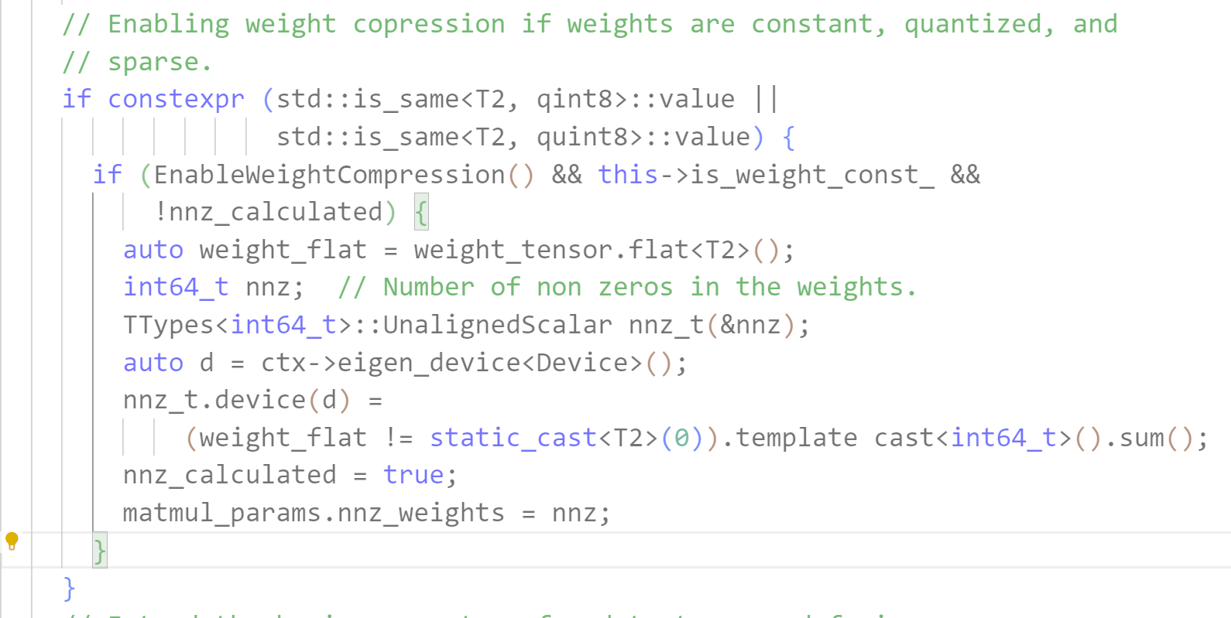
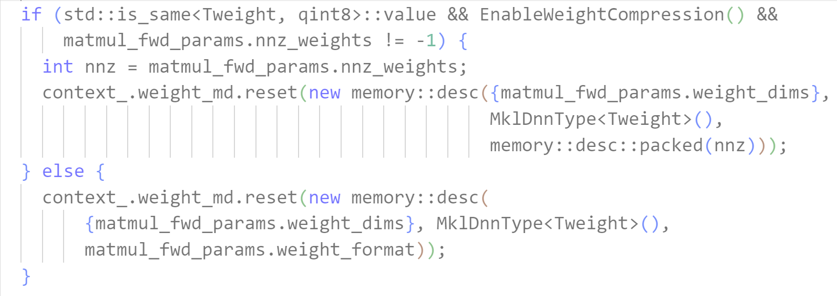
TensorFlow
tensorflow/core/kernels/mkl/mkl_matmul_op_fused.cc
tensorflow/core/kernels/mkl/mkl_matmul_ops_common.h

Slide 21
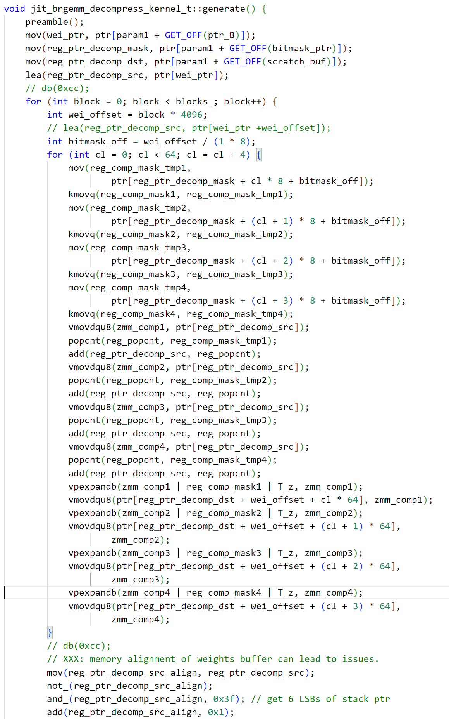
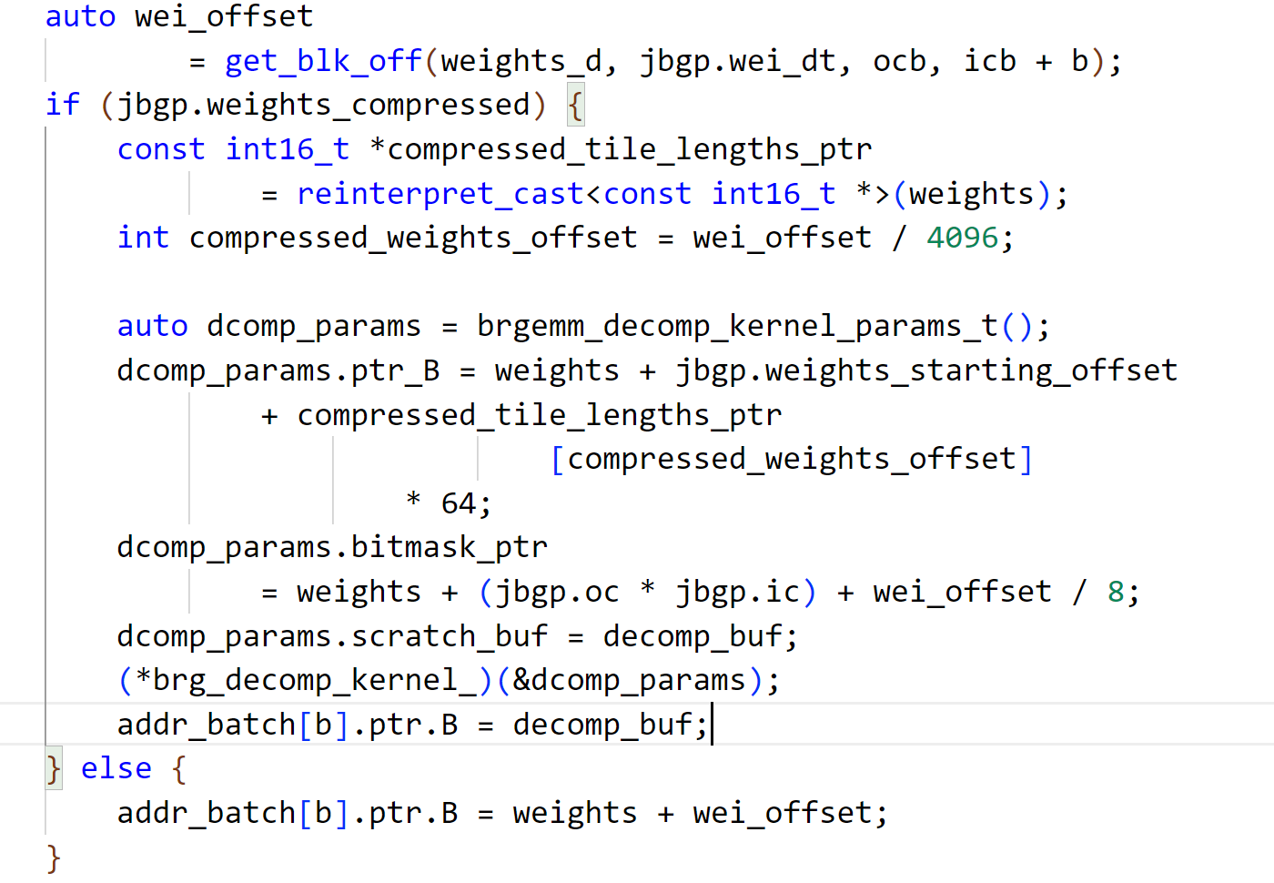
oneDNN
src/cpu/x64/jit_brgemm_decompress_kernel.cpp
src/cpu/x64/jit_brgemm_inner_product.cpp

Slide 22
RESULTS

Slide 23
Notices & Disclaimers
Performance varies by use, configuration and other factors. Performance results are based on testing as of dates shown in configurations and may not reflect all publicly available updates. No product or component can be absolutely secure.
All product plans and roadmaps are subject to change without notice. Results that are based on pre-production systems and components as well as results that have been estimated or simulated using an Intel Reference Platform (an internal example new system), internal Intel analysis or architecture simulation or modeling are provided to you for informational purposes only. Results may vary based on future changes to any systems, components, specifications, or configurations. Intel technologies may require enabled hardware, software or service activation.
No license (express or implied, by estoppel or otherwise) to any intellectual property rights is granted by this document. Code names are used by Intel to identify products, technologies, or services that are in development and not publicly available. These are not "commercial" names and not intended to function as trademarks.
Intel contributes to the development of benchmarks by participating in, sponsoring, and/or contributing technical support to various benchmarking groups, including the BenchmarkXPRT Development Community administered by Principled Technologies.
Statements in this presentation that refer to future plans and expectations are forward-looking statements that involve a number of risks and uncertainties. Words such as "anticipates," "expects," "intends," "goals," "plans," "believes," "seeks," "estimates," "continues," "may," "will," "would," "should," "could," and variations of such words and similar expressions are intended to identify such forward-looking statements. Statements that refer to or are based on estimates, forecasts, projections, uncertain events or assumptions, including statements relating to future products and technology and the expected availability and benefits of such products and technology, market opportunity, and anticipated trends in our businesses or the markets relevant to them, also identify forward-looking statements. Such statements are based on management's current expectations and involve many risks and uncertainties that could cause actual results to differ materially from those expressed or implied in these forward-looking statements. Important factors that could cause actual results to differ materially from the company's expectations are set forth in Intel’s reports filed or furnished with the Securities and Exchange Commission (SEC), including Intel’s most recent reports on Form 10-K and Form 10-Q, available at Intel’s investor relations website at www.intc.com and the SEC’s website at www.sec.gov. Intel does not undertake, and expressly disclaims any duty, to update any statement made in this presentation, whether as a result of new information, new developments or otherwise, except to the extent that disclosure may be required by law.
Intel does not control or audit third-party data. You should consult other sources to evaluate accuracy.
© Intel Corporation. Intel, the Intel logo, and other Intel marks are trademarks of Intel Corporation or its subsidiaries. Other names and brands may be claimed as the property of others.

Slide 24
Experimental Setup
Name | Server Configuration
Server | 4th Gen Intel® XEON
Cores/socket | 56c, Hyper Threading Enabled
Sockets | 2
DRAM | 16x64GB
OS | CentOS Stream 8
SW Configuration | TensorFlow 2.10
 | OneDNN v2.6.1
Platform | Archer City
Microcode | 0xab000060
Test Date | October 14, 22, October 28, 22
Bert-Large Inference
This has been optimized on inner-product kernels in oneDNN and TensorFlow
Workload Configuration
56 instances, 2 cores per instance, with NUMA and Memory binding

Slide 25
Bert-Large Inference Performance (sentences/sec)
1.36x
This solution with 90% unstructured sparse model provides up to 7.2x gain over base FP32 dense model with ~2% accuracy loss
See backup for workloads and configurations. Results may vary.

Slide 26
Perf scaling for INT8 model: With/Without Sparse Weight Compression
Significant performance gain with increase of sparsity due to higher compression capability leading to improved AMX/TMUL utilization & memory BW savings
Performance gain increases with smaller sequence length as compute density lowers with more memory access
See backup for workloads and configurations. Results may vary.

Slide 27
Memory Read Bandwidth on 90% Sparse Model with Varying Seq-Lengths
1.39x
1.98x
1.8x
With Sparse Weight Compression, total memory BW can be saved up to 50%
See backup for workloads and configurations. Results may vary.

Slide 28
LLC MPI (Misses Per Instruction). Lower is better
With the reduction of memory boundness, last level cache (LLC) MPI can be reduced up to ~3.23x while using Sparse Weight Compression
See backup for workloads and configurations. Results may vary.

Slide 29
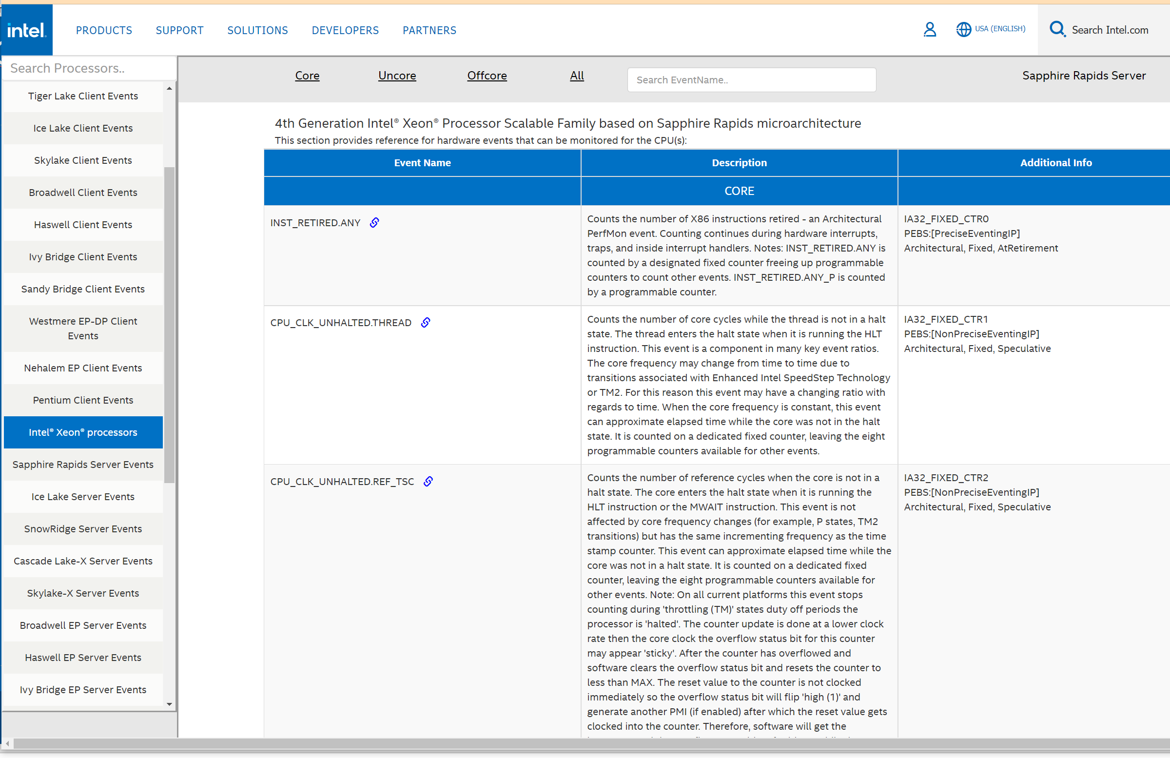
Perfmon Events
Performance monitoring events supported by Intel Performance Monitoring Units (PMUs)
The PMU is hardware built inside a processor to measure its performance parameters such as
instruction cycles,
cache hits, cache misses,
branch misses, etc.
Performance monitoring events provide facilities to characterize the interaction between programmed sequences of instructions and microarchitectural sub-systems.
https://perfmon-events.intel.com/
Notes:
Public Doman

Slide 30
INTEL® PERFORMANCE COUNTER MONITOR (Intel® PCM)

Slide 31
Intel® Performance Counter Monitor (Intel® PCM)
https://github.com/intel/pcm
Intel® Performance Counter Monitor (Intel® PCM) is an application programming interface (API) and a set of tools based on the API to monitor performance and energy metrics of Intel® Core™, Xeon®, Atom™ and Xeon Phi™ processors.
PCM Tools
Command-line utilities for real-time monitoring

Slide 32
PCM command line real-time utilities
pcm : basic processor monitoring utility (instructions per cycle, core frequency (including Intel(r) Turbo Boost Technology), memory and Intel(r) Quick Path Interconnect/Ultra Path Interconnect bandwidth, local and remote memory bandwidth, cache misses, core and CPU package sleep C-state residency, core and CPU package thermal headroom, cache utilization, CPU and memory energy consumption)
pcm-memory : monitor memory bandwidth (per-channel and per-DRAM DIMM rank)
pcm-latency : monitor L1 cache miss and DDR/PMM memory latency
pcm-pcie : monitor PCIe bandwidth per-socket
pcm-iio : monitor PCIe bandwidth per PCIe device
pcm-numa : monitor local and remote memory accesses
pcm-power : monitor sleep and energy states of processor, Intel(r) Quick Path Interconnect, DRAM memory, reasons of CPU frequency throttling and other energy-related metrics
pcm-tsx: monitor performance metrics for Intel(r) Transactional Synchronization Extensions
pcm-sensor-server : pcm collector exposing metrics over http in JSON or Prometheus (text based) format
pcm daemon: pcm collector exposing metrics over shared memory (inter-process communication)
pcm-core and pmu-query: query and monitor arbitrary processor core events
pcm-bw-histogram: collect memory bandwidth utilization histogram
pcm-msr/pcm-pcicfg: cross-platform register access utilities

Slide 33
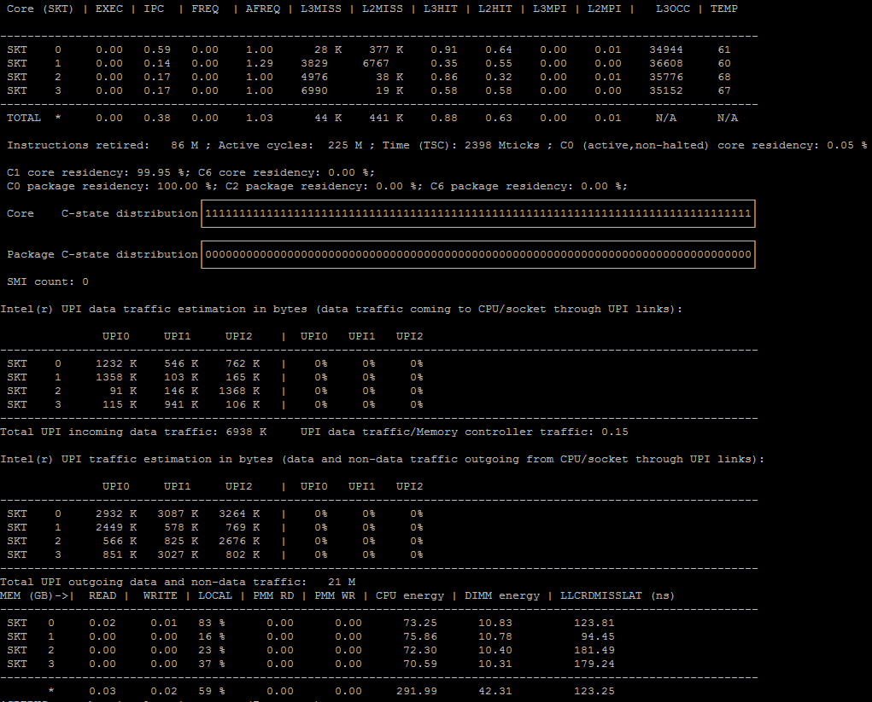
pcm
instruction per cycle, cache hits/misses, cache usage temp headroom
C-state core and package (sleep states)
UPI (cross-socket) traffic and link utilization
data and non-data (snoops, protocol overhead)
Consumed memory bandwidth (DRAM and PMEM), locality of access, CPU/memory energy, cache miss latency

Slide 34
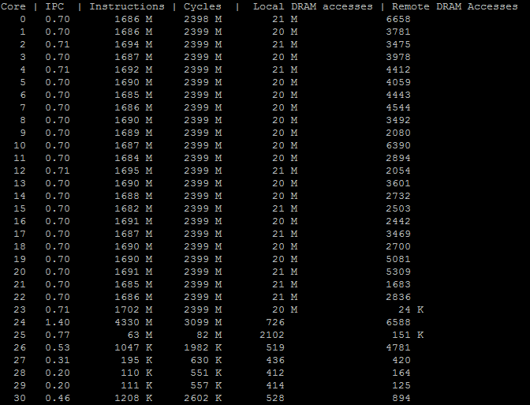
pcm-numa
The number of local and remote DRAM memory accesses per-core

Slide 35
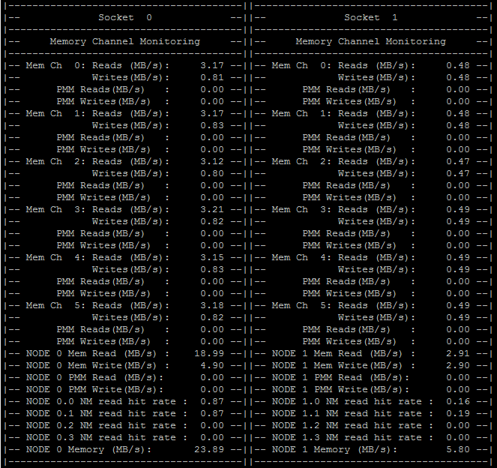
pcm-memory
Monitor memory per-channel and per DIMM rank
PMem channel bandwidth
PMem „Memory Mode“ DRAM cache hit rate

Slide 36
Summary
By utilizing Sparse Weight Compression technique, we’ve demonstrated that you can get up to 1.87x in performance gain and save up to 50% memory bandwidth
Next Steps
Continue to enable other DNNL models
System level optimization

Slide 38
BACKUP

Slide 39
4th Gen Intel® Xeon® Scalable Processor - Intel® AI Engines supporting Solution Stack
Customer Workloads
(Healthcare, Video analysis, medical imaging…)
Leading ecosystem BFloat16/INT8 adoption on Intel® Xeon® Scalable Processor with comparable FP32 performance
Deep expertise in solutions engineering resulting in optimizations across popular open-sourced frameworks to showcase advantages of new AI Engine technology
Intel® AMX/TMUL Optimized Intel® oneDNN library for BFloat16/INT8 deep learnings primitives
Topologies
Frameworks
oneDNN Library
OS
4th Gen Intel® Xeon® Scalable Processor with AI Engine®

Slide 40
Quantization - workflow
Convert model to bfloat16 precision
Quantize model with dynamic scale and shift parameters
Freeze weight-variables as constant
Calibrate scale and shift parameters
Train model with float32 precision
Optimized quantized model

Slide 41
Sparsity Introduction to Models
A sparse model can be obtained by applying weight pruning, while training the model some of the weights are forced to zero
Weight pruning BERT without accuracy loss have proven to be a difficult task
Prune Once For All (OFA) is a method to create sparse pre-trained LM [1]
Prune OFA models can be fine-tuned with minimal accuracy loss to several common NLP benchmarks
Prune OFA presented a new metrology for producing sparse Transformer models with the simplicity of a simple fine-tuning
[1] https://arxiv.org/pdf/2111.05754.pdf

Slide 42
Zero Compression
Weights Dimension | Weights (Bytes) | Sparsity | Non-zero-values (bytes) | bitmasks (bytes) | zero Compressed (Bytes) | Ratio
1024 x 1024 | 1,048,576 | 90% | 104,858 | 131,072 | 235,930 | 4.44
1024 x 1024 | 1,048,576 | 80% | 209,715 | 131,072 | 340,787 | 3.07
1024 x 1024 | 1,048,576 | 70% | 314,573 | 131,072 | 445,645 | 2.33
Bert-Large Weights
ic | oc | # occurances/itr | Total Size | in MB
4096 | 1024 | 24 | 100,663,296 | 96
1024 | 4096 | 24 | 100,663,296 | 96
1024 | 2 | 1 | 2,048 | 0.002
1024 | 1024 | 96 | 100,663,296 | 96
 |  |  |  | 288

